Slide 1

Covid19 - Analysis Using BIT
Aadityan

Slide 2
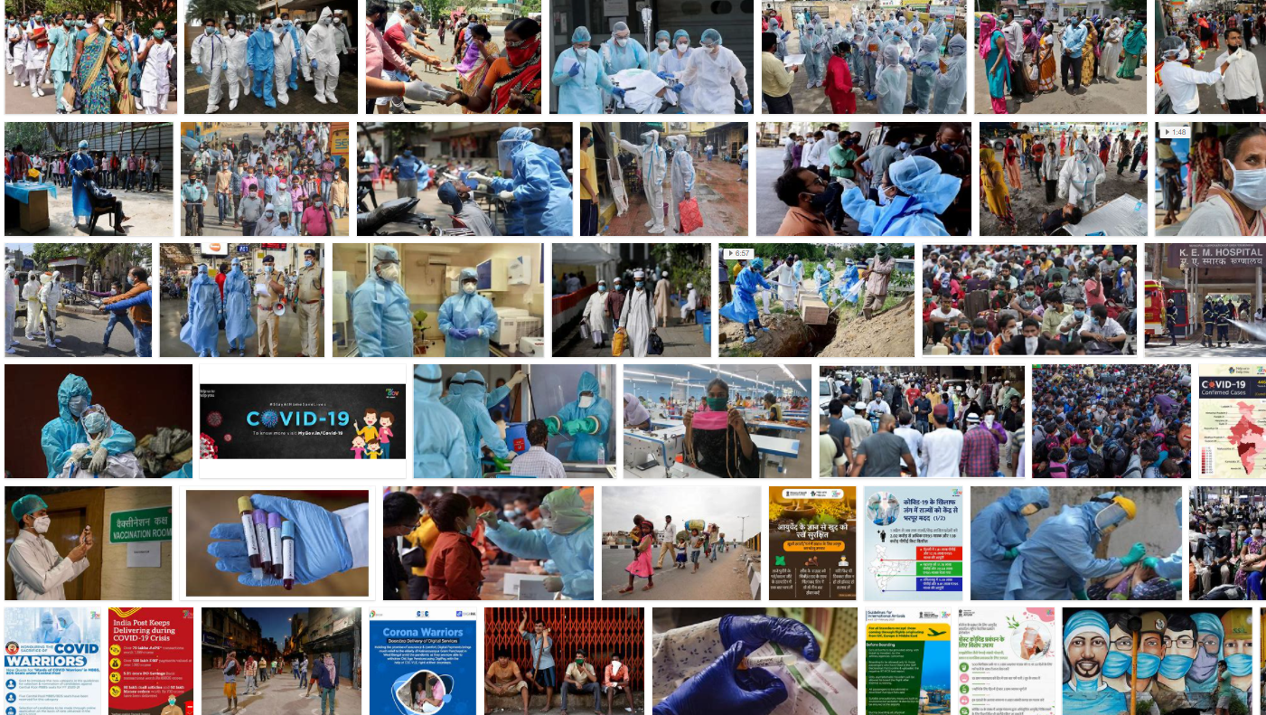
Covid-19 March Analysis
Today when you hear the work “Covid” we are reminded of “terror”
There is Panic Everywhere!
What is the role BIT structure can play in statistical Analysis?
Our Shocking Results

Slide 3
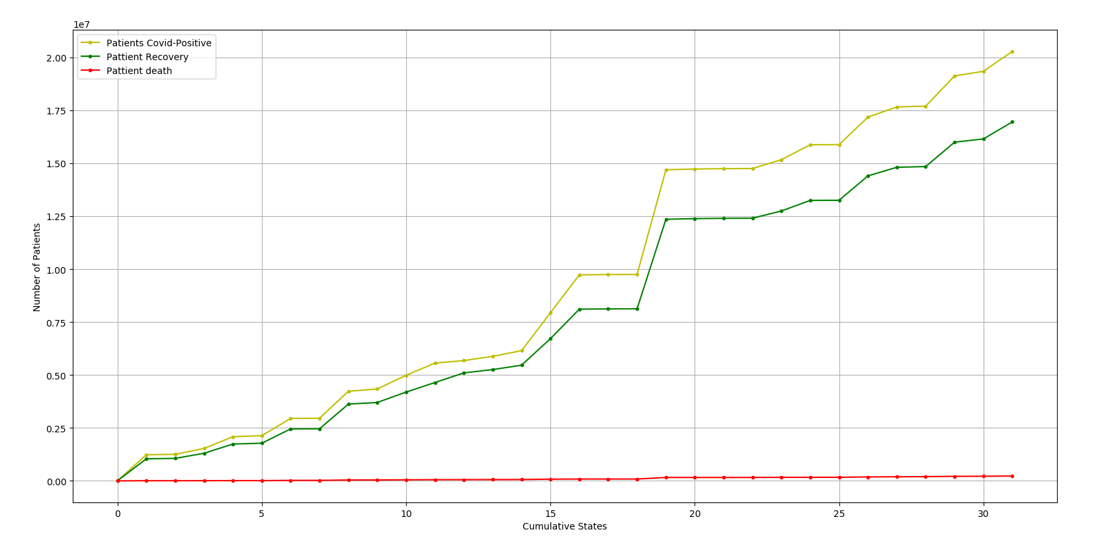
Our Analysis
Inference
Dataset
Code explanation

Slide 4
Panic => Solutions

